Slide 1
GPRS { Global Packet Radio System }
Name : Vipin Patel
Roll No: 63
Submitted to : Mrs. Kanika Mam

Slide 2
General Packet Radio System
• General Packet Radio Services (GPRS) is a packet-based wireless communication service that promises data rates from 56 up to 114 Kbps and continuous connection to the Internet for mobile phone and computer users.
• The higher data rates allow users to take part in video conferences and interact with multimedia Web sites and similar applications using mobile handheld devices as well as notebook computers.
• GPRS is based on Global System for Mobile (GSM) communication and complements existing services such as circuit switched cellular phone connections and the Short Message Service (SMS)

Slide 3
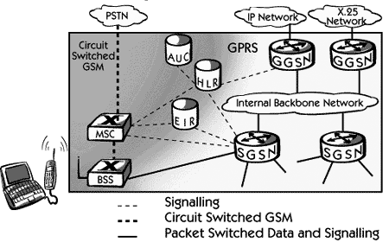
GpRS Architecture

Slide 4
main Elements of gprs
GPRS MOBILE STATIONS :: Mobile Station is required to access GPRS services.
GPRS BASE STATION SUBSYSTEMS :: When either voice or data traffic is originated at the subscriber mobile, it is transported over the air interface to the BTS.
GPRS SUPPORT NODES
Gateway GPRS Support Node ( GGSN)
Serving GPRS Support Node SGSN
INTERNAL BACKBONE :: The internal backbone is an IP based network used to carry packets between different GSNs.
ROUTING AREA :: Routing area is similar to Locating Area in GSM, except that it generally contains fewer cells.

Slide 5
GOALS OF gPRS
GPRS is the first step toward an end-to-end wireless infrastructure and has the following goals:
Open architecture
Consistent IP services
Same infrastructure for different air interfaces
Integrated telephony and Internet infrastructure
Leverage industry investment in IP
Service innovation independent of infrastructure

Slide 6
Thank you

